Slide 1
Week 1 Lab
Develop a basic HTML page for your targeted application (say healthcare, e-commerce, ticket booking/any other - don't focus much on graphics, take a few text and number inputs), save the data in XML format and then write a Java code for parsing the XML file to display the entered data in HTML table.
Target application: - health care application
Github link
Yamani Nikhil Chowdary
AP20110010067

Slide 2
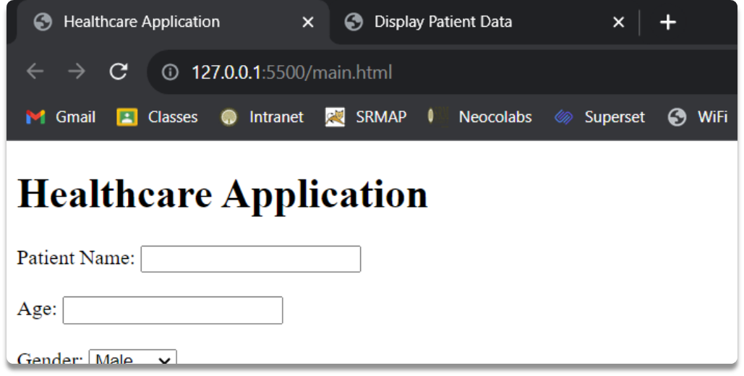
Step 1
Construct an HTML page tailored to a particular application. In this instance, I've generated a page dedicated to the "Healthcare Application."

Slide 3
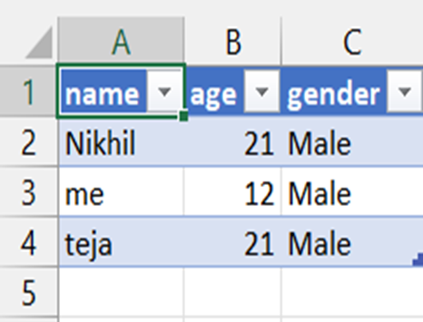
Step 2
A server has been established to store all the inputted information within an XML file. Upon the client entering data into the "Healthcare Application" page, all of this data is subsequently stored within the XML file.

Slide 4
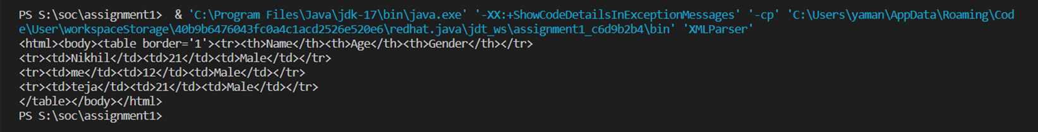
Step 3
A Java program designed to extract data from an XML file and then present the XML file's contents within an HTML page.

Slide 5
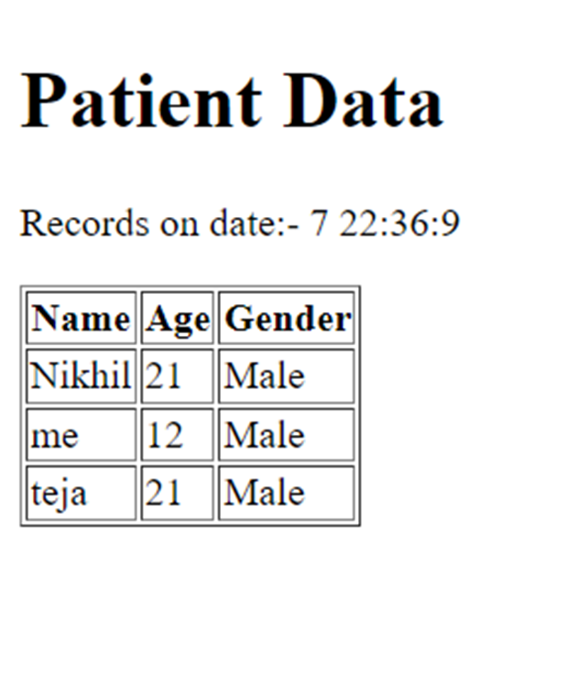
Step 4
In the end, the complete contents of the XML file are showcased within an HTML page.

